Slide 1

Enginius Segmentation
Vaibhav Singh, UNIVERSITY OF SOUTHERN CALIFORNIA
Copyright (c) 2022, DecisionPro Inc.

Slide 2
Data transformation

Slide 3
Data transformation
Standardization has not been performed.

Slide 4
Segment solution

Slide 5
3-segment solution
The ideal number of segments is a function of statistical fit (what the data say), managerial relevance (what makes the most sense from a managerial point of view), and targetability (can the segments be easily targeted).
When the three criteria do not perfectly converge, selecting the right number of segments becomes a judgment call.
You have decided to perform the analysis with 3 segments.
The segmentation method relies on the hierarchical clustering approach. This approach generates a dendrogram that we display next.

Slide 6
Dendrogram
The dendrogram represents the grouping process of observations into clusters. The chart reads from bottom (all initial observations are separated) to top (all observations are clustered into one unique segment).
The height represents the distance between the two groups of observations being merged at each step. If two very distant groups are being merged, this will create a 'jump' in the dendrogram, indicating that it might be wise to stop the clustering process before.

Slide 7
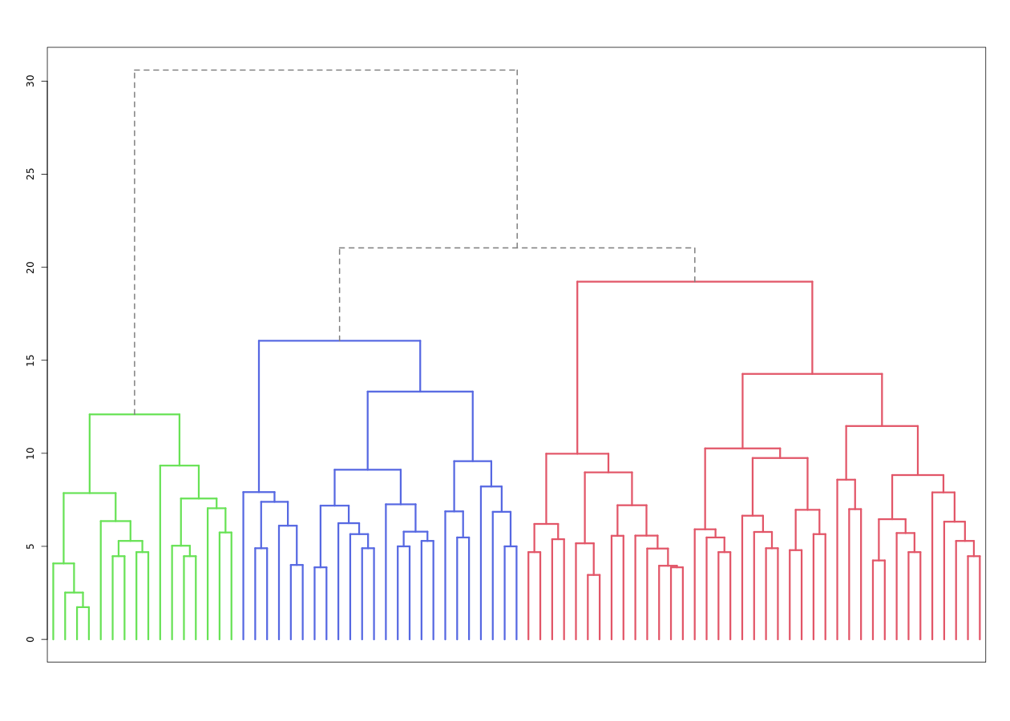
Dendrogram
The dendrogram is a tree diagram to illustrate the arrangement of clusters produced by hierarchical clustering, and how the observations are incrementally clustered together.

Slide 8
Scree plot
The screeplot displays, for each cluster solution, a measure of within-cluster heterogeneity. If clusters group observations that are widely different (which will happen if the number of clusters is too small to capture the variability in the data), the value will be high.
A good cluster solution might be where the screeplot displays an 'elbow', that is, where increasing the number of clusters beyond a certain point does not dramatically decreases within-cluster heterogeneity.
The measure displayed in the screeplot is related, but not equivalent, to the distance reported in the dendrogram.
From a statistical point of view, the SSE reported in the screeplot is computed as the sum of squared error between each observation and its cluster centroid (or center), summed over all the observations.

Slide 9
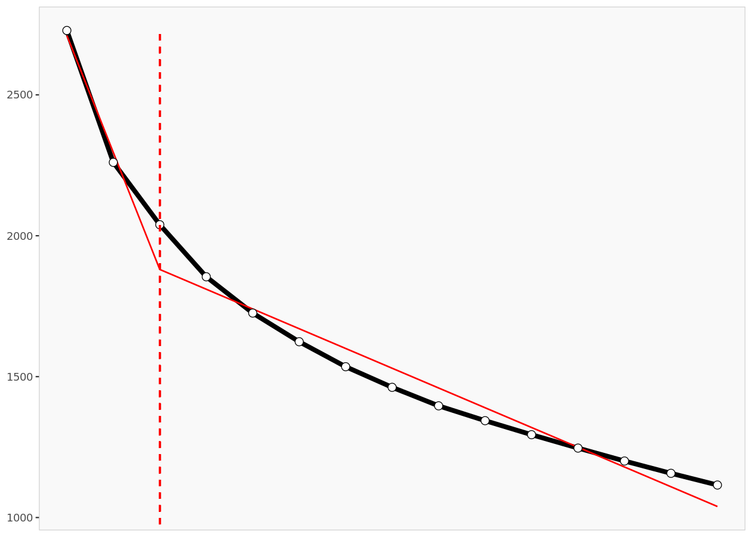
Scree plot
The scree plot compares the sum of squared error (SSE) for each cluster solution. A good cluster solution might be when the SSE slows dramatically, creating an 'elbow'. Such elbow does not always exist.

Slide 10
Segment description

Slide 11
Segment size
 | Population | Segment 1 | Segment 2 | Segment 3
Size | 79 | 39 | 16 | 24
Relative size | 100% | 49% | 20% | 30%

Slide 12
Segment description
 | Population | Segment 1 | Segment 2 | Segment 3
Cofee_Likeness | 3.75 | 3.87 | 2.50 | 4.38
Coffee_strong_factor | 2.90 | 2.95 | 2.38 | 3.17
Coffee_Shop_visit_frequency | 2.75 | 2.95 | 1.88 | 3.00
Days_of_week_drinks_cofee_code | 2.34 | 2.33 | 1.38 | 3.00
frequency_making_own_coffee | 2.87 | 2.77 | 1.75 | 3.79
frequency_of_coffee_purchase | 2.73 | 2.85 | 1.75 | 3.21
Importance_of_coffee_brand | 3.16 | 3.41 | 2.06 | 3.50
Coffee_knowledge | 2.58 | 2.62 | 1.88 | 3.00
Coffee_spend_monthly_code | 2.57 | 2.62 | 1.38 | 3.29
Quality_of_Coffee_imp | 3.86 | 4.44 | 2.63 | 3.75
Staff_Attitude_imp | 3.30 | 4.03 | 2.13 | 2.92
Service_speed_imp | 3.67 | 4.15 | 2.44 | 3.71
Ease_of_Online_Ordering | 2.96 | 3.56 | 2.19 | 2.50
Store_Cleanliness | 4.01 | 4.62 | 2.94 | 3.75
Variety_Of_Flavors | 2.97 | 3.56 | 2.38 | 2.42
Customizability | 2.85 | 3.49 | 2.38 | 2.13
Knowledgeable_Staff | 3.13 | 3.69 | 2.19 | 2.83
Store_Comfortable_Seating | 3.28 | 3.87 | 2.38 | 2.92
Unique_Drinks | 2.65 | 3.13 | 2.19 | 2.17
Store_Proximity | 3.61 | 4.00 | 2.44 | 3.75
Affordability | 3.67 | 4.10 | 3.00 | 3.42
Shop_Surroundings | 3.19 | 3.79 | 2.06 | 2.96
Good_place_to_study_or_work | 3.09 | 3.79 | 2.00 | 2.67
Quality_Consistency | 3.96 | 4.49 | 2.75 | 3.92

Slide 13
Segment description (...)
Average value of each segmentation variable, overall for each segment (centroid). Segmentation variables that are statistically different from the rest of the population are highlighted in red (lower) or green (higher).

Slide 14
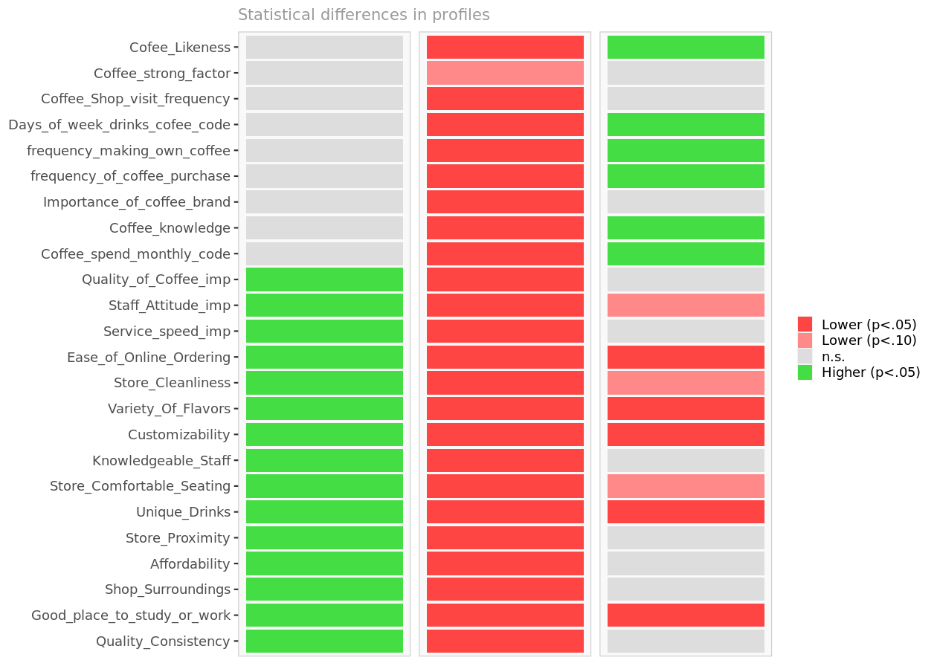
Segment differences per segment
Cell colors indicate to what extent a segment is statistically different from the rest of the population on each segmentation variable.

Slide 15
Segmentation space
The chart below is a graphical representation of the various segments, segment members, and segmentation variables. It is obtained by plotting the first two dimensions of a principal component analysis performed on the (standardized) segmentation data, on top of which segment information has been overlaid.
Because only the first two dimensions of the PCA are displayed, and these two dimensions capture only 46.2% of the variance in the data, some differences between segments might not appear here. Note that segmentation variables with no variance, if any, have been excluded.
Two clusters that appear to overlap on the first two dimensions might be distinct on other dimensions. Consequently, this chart is a useful guide, for checking which variables are correlated, but may be misleading if used to select the optimal number of segments.

Slide 16
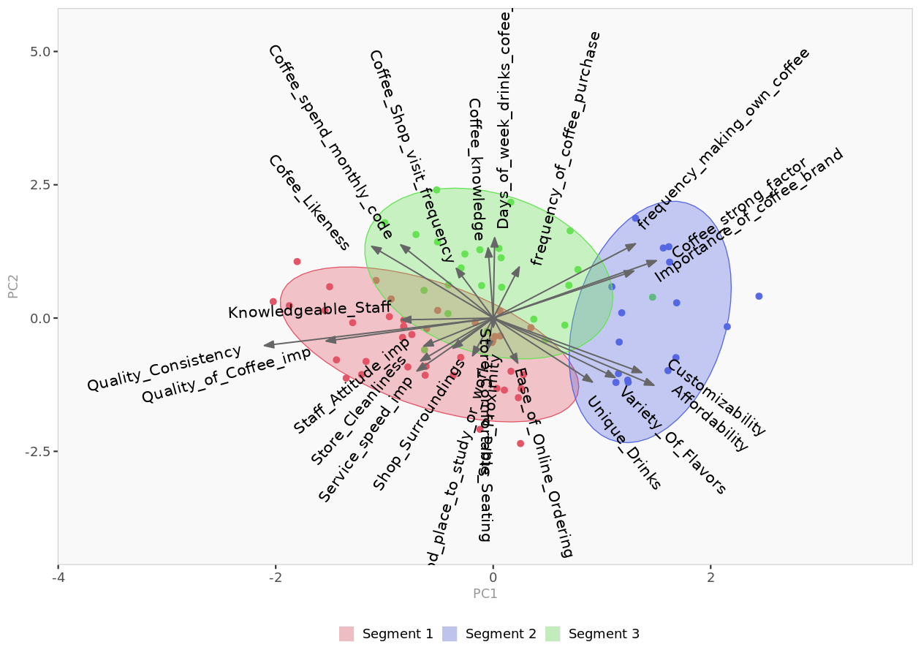
Segment space
Spatial representation of segments and segmentation variables, using principal component analysis.

Slide 17
Segment membership (excerpt)
 | Segment
1 | 1
2 | 2
3 | 1
4 | 1
5 | 1
6 | 3
7 | 1
8 | 3
9 | 1
10 | 1

Slide 18
Segment membership (...)
Segment to which each member of the population belongs to. The complete membership list is only available in the Excel formatted output.

Slide 19
Segment profiles

Slide 20
Spider chart
Spider chart comparing the averages of the segmentation variables across all segments.

Slide 21
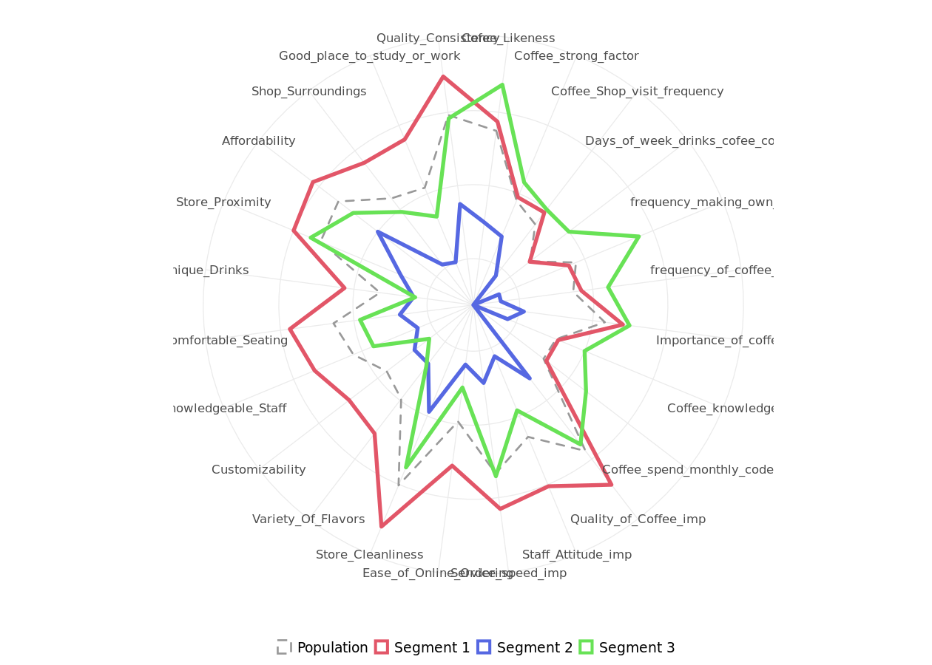
Spider chart

Slide 22
Segment 1 profile
The following charts represent the profile of each segment. These charts are only available when the data are not standardized, hence the model assumes that all segmentation variables use the same scale.
For each segment, the segmentation variables are ordered in decreasing order of magnitude.
The colored dots represent the average of the segment.
The horizontal lines represent the standard deviations within that segment.
The vertical, gray lines represent the averages of the rest of the population, after excluding members of the segment under scrutiny.

Slide 23
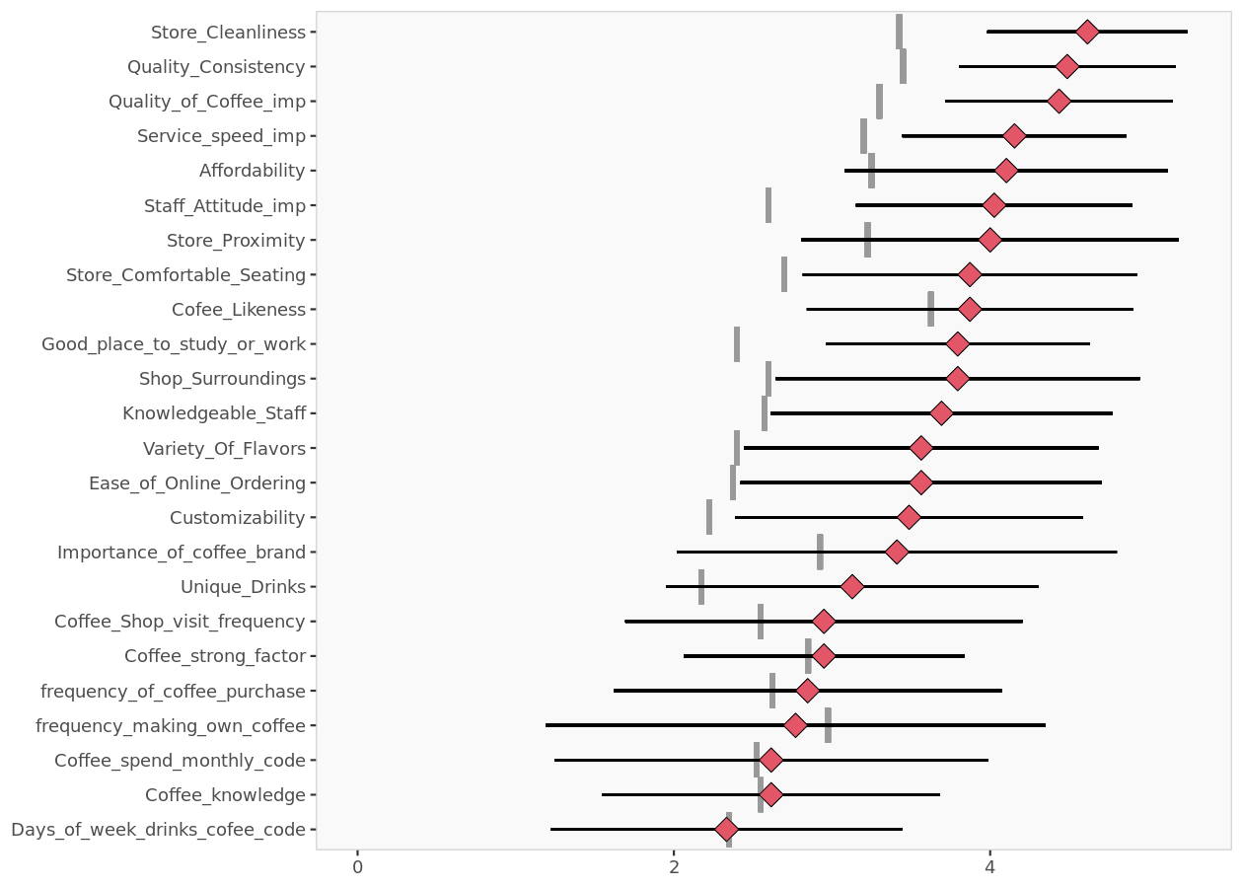
Segment 1 profile

Slide 24
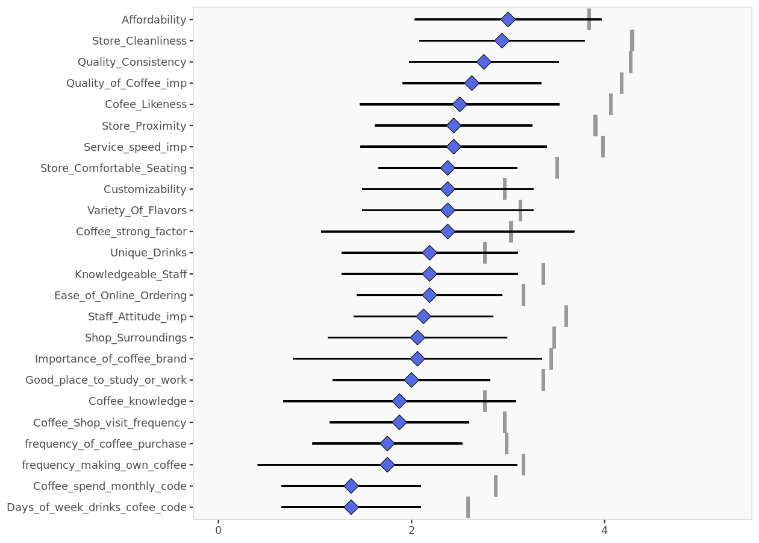
Segment 2 profile

Slide 25
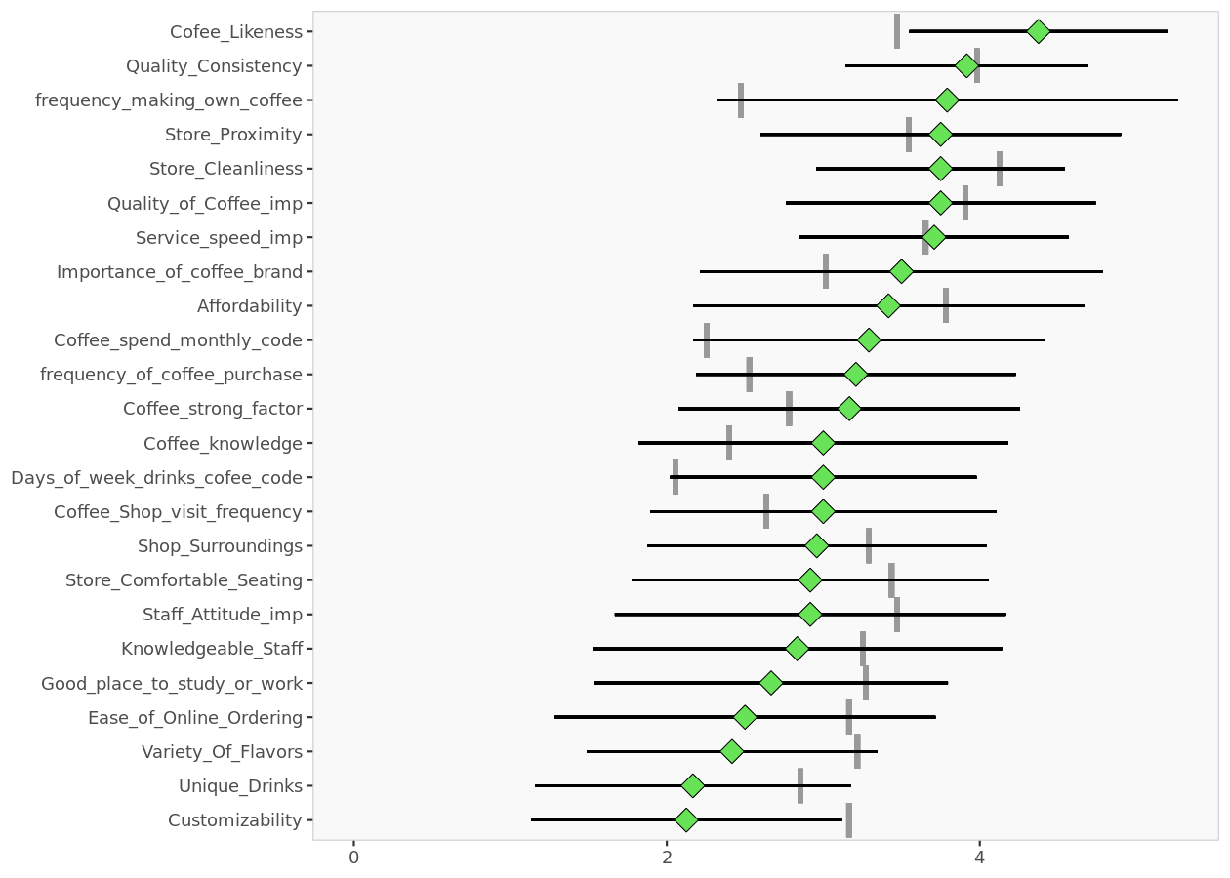
Segment 3 profile

Slide 26
Descriptor analysis

Slide 27
Descriptors
This table reports the descriptor averages of each segment. The more differences can be found, the easier it will be to predict segment membership based on descriptors alone.

Slide 28
Descriptor data per segment
 | Population | Segment 1 | Segment 2 | Segment 3
Gender = Male | 0.519 | 0.564 | 0.500 | 0.458
State = California | 0.924 | 0.897 | 0.938 | 0.958
Highest Education = Graduate | 0.747 | 0.744 | 0.875 | 0.667
Highest Education = Undergraduate | 0.215 | 0.205 | 0.125 | 0.292
Are you currently working? | 0.494 | 0.462 | 0.313 | 0.667
Age_code | 1.72 | 1.74 | 1.69 | 1.71
Average value of each descriptor, overall and within each cluster. Descriptors that are statistically different from the rest of the population are highlighted in red (lower) or green (higher).

Slide 29
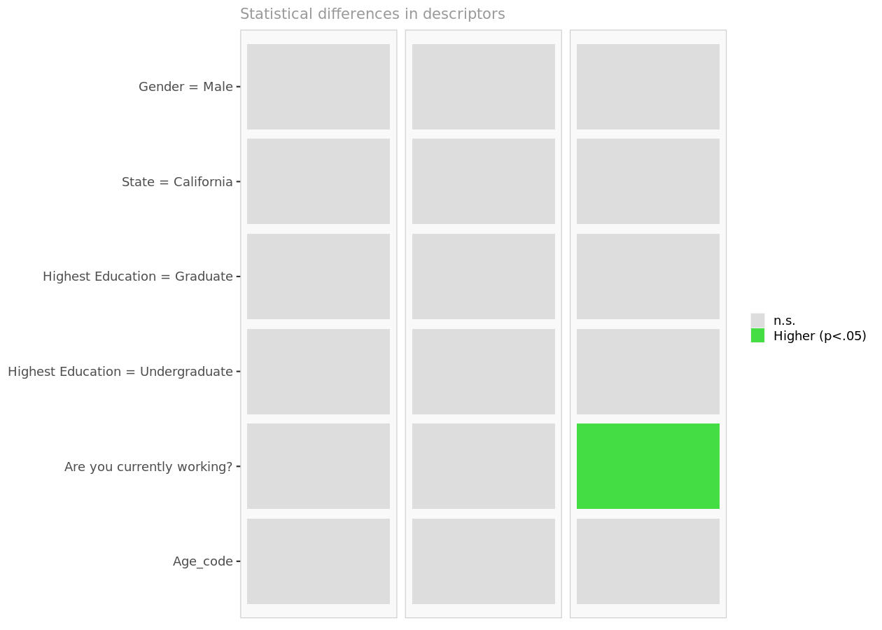
Descriptor differences per segment
Cell colors indicate to what extent the distribution of a descriptor in a segment is statistically different from the rest of the population.

Slide 30
Descriptor space
The chart below is a graphical representation of the various segments, segment members, and descriptors. It is obtained by outputing the first two dimensions of a principal component analysis performed on the (standardized) descriptors, on top of which segment information has been overlayed.
Because only the first two dimensions of the PCA are displayed, and these two dimensions capture only 54.0% of the variance in the data, some differences between segments might not appear here. Note that descriptors with no variance, if any, have been excluded.
If two or more segments fully overlap, it is unlikely that they could be clearly separated based on descriptors alone.
However, two segments that seem to overlap on two dimensions may be more clearly separated on other dimensions. Consequently, the confusion matrix is a better guide to assess the quality of segment classification based on descriptors.

Slide 31
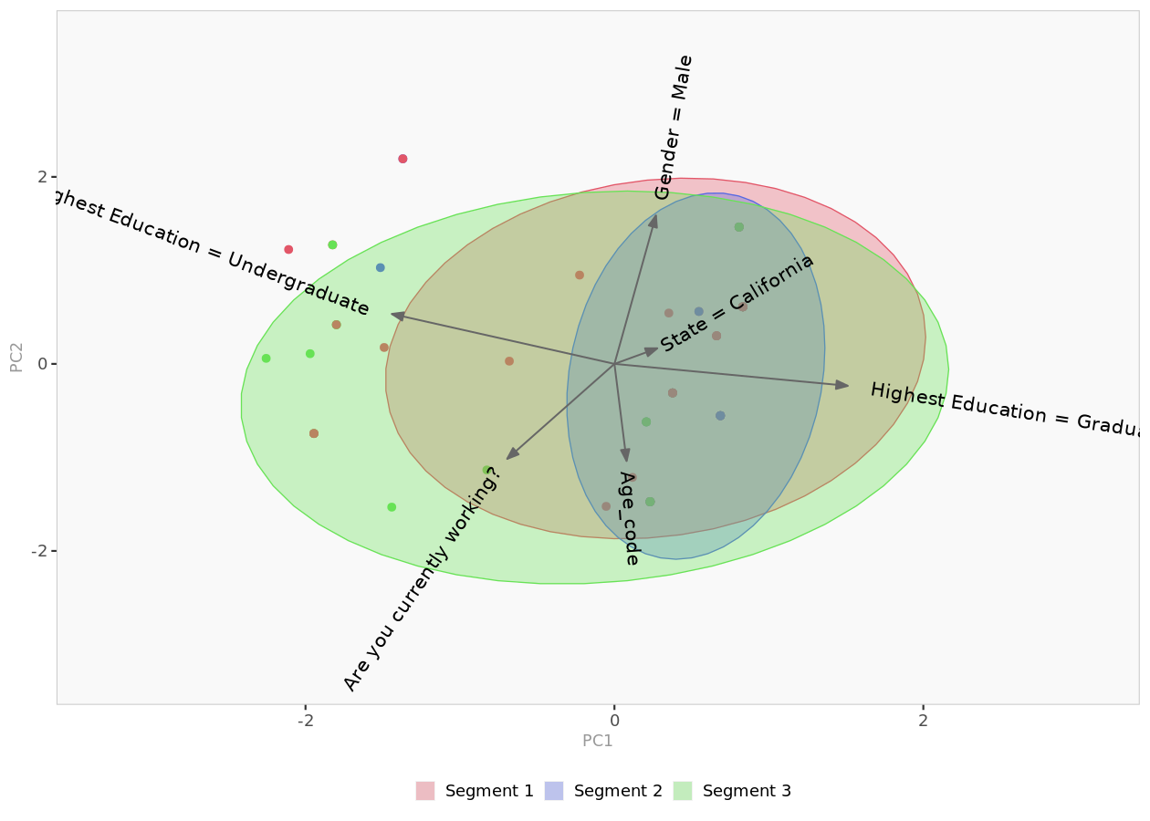
Descriptor space
Spatial representation of segments and their descriptors, using principal component analysis.

Slide 32
Classification model

Slide 33
Introduction
Often, segmentation (needs) variables for each customer may not be available to managers, but descriptors variables for customers may be available.
In this section, we explore whether descriptors alone can predict segment membership with sufficient accuracy. The confusion matrix and hit rates (reported below) indicate whether the model is accurate enough.
For member classification based on descriptors, Enginius uses a multinomial logit model (similar to the one used to predict 'choices between multiple alternatives (A/B/C)' in the predictive modeling module.
The largest segment is selected as the default option (dummy), and the model identifies which descriptors are the most significant for predicting cluster memberships. If a descriptor is highly predictive, its p-values will be close to zero, and the cells will appear in green (or red).

Slide 34
Model parameters
 | Segment 2 | Segment 3
(Intercept) | -11.18 | -2.02
Gender = Male | -0.368 | -0.220
State = California | 0.328 | 1.193
Highest Education = Graduate | 10.739 | 0.269
Highest Education = Undergraduate | 10.203 | 0.578
Are you currently working? | -0.569 | 0.838
Age_code | -0.114 | -0.158
Segment 1 is the model baseline.

Slide 35
p-values
 | Segment 2 | Segment 3
(Intercept) | 0.963 | 0.339
Gender = Male | 0.559 | 0.689
State = California | 0.784 | 0.317
Highest Education = Graduate | 0.964 | 0.837
Highest Education = Undergraduate | 0.966 | 0.675
Are you currently working? | 0.395 | 0.144
Age_code | 0.836 | 0.754
Probabilities that parameter estimates are different from zero only by chance.

Slide 36
Confusion matrix
The confusion matrix compares actual segment membership (obtained from the segmentation analysis and the original segmentation variables) and predicted segment membership (obtained from the in-sample classification analysis and the descriptors alone). When actual and predicted segment memberships coincide, the diagonal elements will be comparatively large, indicating that the classification model based on available descriptors is accurate.

Slide 37
Confusion matrix (count)
 | Predicted 1 | Predicted 2 | Predicted 3 | Total
Segment 1 | 34 | 0 | 5 | 39
Segment 2 | 15 | 0 | 1 | 16
Segment 3 | 16 | 0 | 8 | 24
Total | 65 | 0 | 14 | 79
The model has correctly classified 42 of the 79 observations. The off-diagonal elements are classification errors.

Slide 38
Confusion matrix (%)
 | Predicted 1 | Predicted 2 | Predicted 3 | Total
Segment 1 | 87% | 0% | 13% | 100%
Segment 2 | 94% | 0% | 6% | 100%
Segment 3 | 67% | 0% | 33% | 100%
The global hit rate of the model is 53%. The diagonal elements represent segment-specific hit rates.

Slide 39
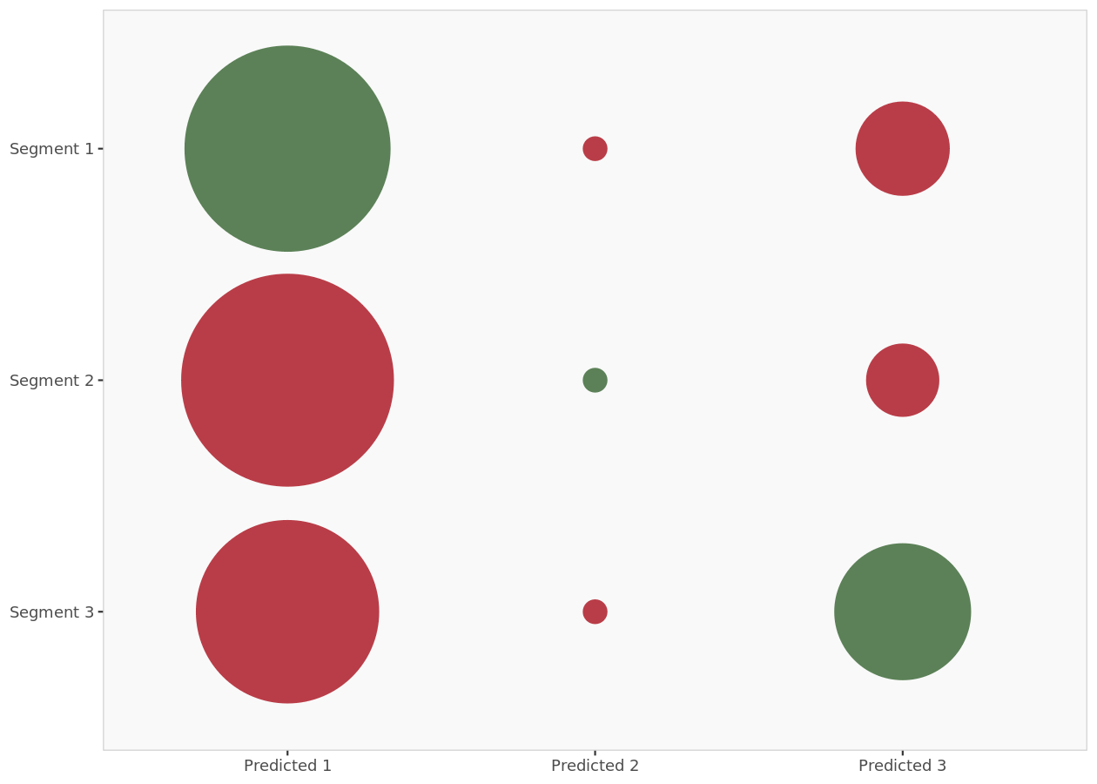
Confusion matrix (plot)
Graphic representation of the confusion matrix: actual segment membership versus predicted segment membership. Bubbles in the diagonale represent correct classification.

Slide 40
Model predictions (in-sample) (excerpt)
 | Prob(cluster 1) | Prob(cluster 2) | Prob(cluster 3) | Predicted | Actual | Correct
1 | 47% | 33% | 20% | 1 | 1 | 1
2 | 49% | 14% | 38% | 1 | 2 | 0
3 | 44% | 35% | 21% | 1 | 1 | 1
4 | 55% | 27% | 18% | 1 | 1 | 1
5 | 55% | 27% | 18% | 1 | 1 | 1
6 | 49% | 14% | 38% | 1 | 3 | 0
7 | 69% | 24% | 7% | 1 | 1 | 1
8 | 47% | 33% | 20% | 1 | 3 | 0
9 | 63% | 0% | 37% | 1 | 1 | 1
10 | 41% | 8% | 51% | 3 | 1 | 0

Slide 41
Model predictions (in-sample) (...)
This table details the probabilities of each member of the segmentation dataset to belong to each cluster (as predicted by the in-sample classification model and the descriptors alone). The segment with the highest probability is retained, and is compared to the actual segment membership to measure model accuracy and classification errors.

